Slide 1

Netflix Viewership
Taylor Duncan

Slide 2


Define the Story
Pitch a new Netflix original series using Top 10 viewership trends to identify high-engagement genres and formats.

Slide 3

Audience, Purpose & Medium
Audience: Netflix executives & content strategists
Purpose: Secure greenlight for a data-inspired series
Medium: 10–15 slide PowerPoint + Python Notebook

Slide 4
Design Choices
• Color: Netflix red (global) & slate blue (regional)
• Layout: White background, clean fonts, ample whitespace
• Charts: Bars for comparisons, lines for trends

Slide 5
Ethical Considerations
Transformations: Weekly aggregation, top-quartile filter, nulls as zeros
Risks: English-language bias, mitigated by clear labeling
Compliance: Public Top 10 data, no PII, documented assumptions

Slide 6
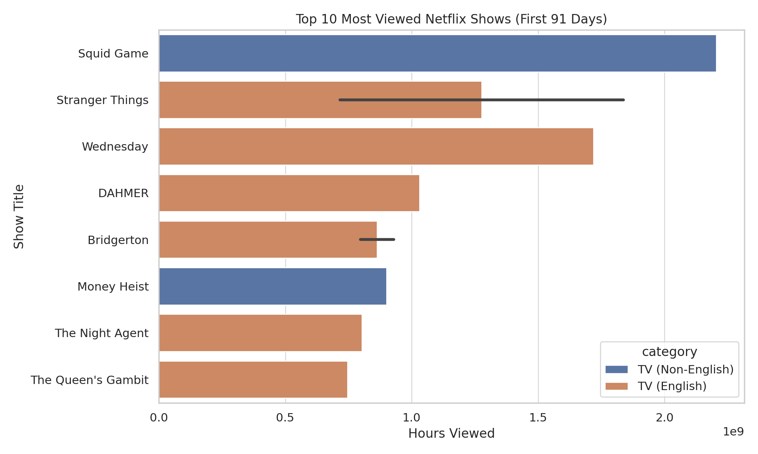
Top 10 Most Viewed Global Shows

Slide 7
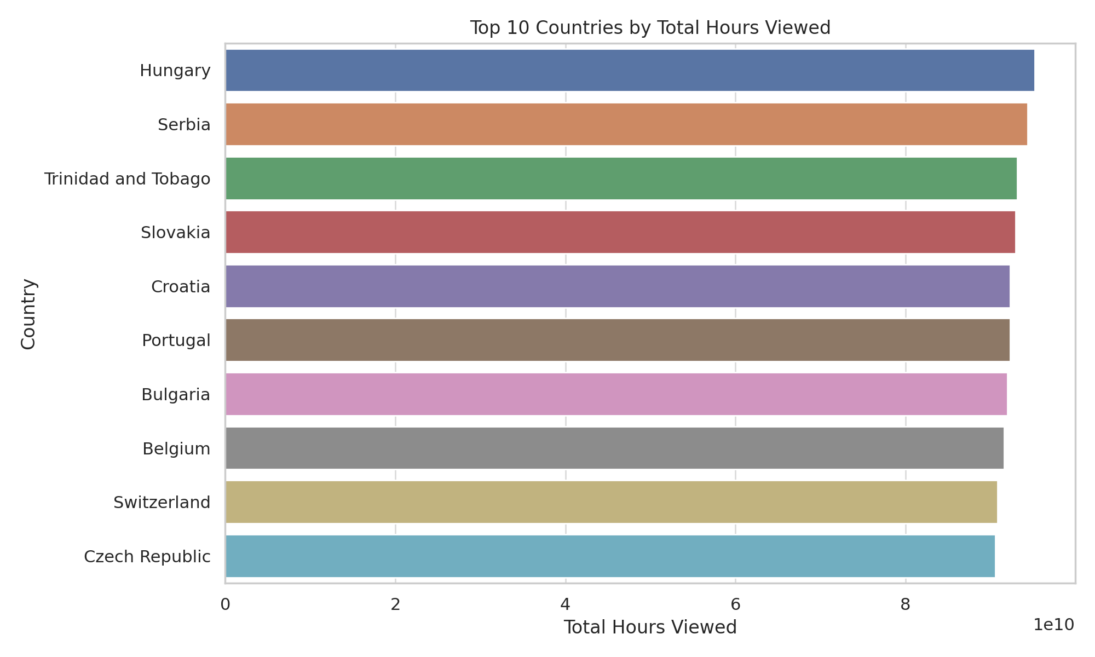
Top 10 Countries by Hours Viewed

Slide 8
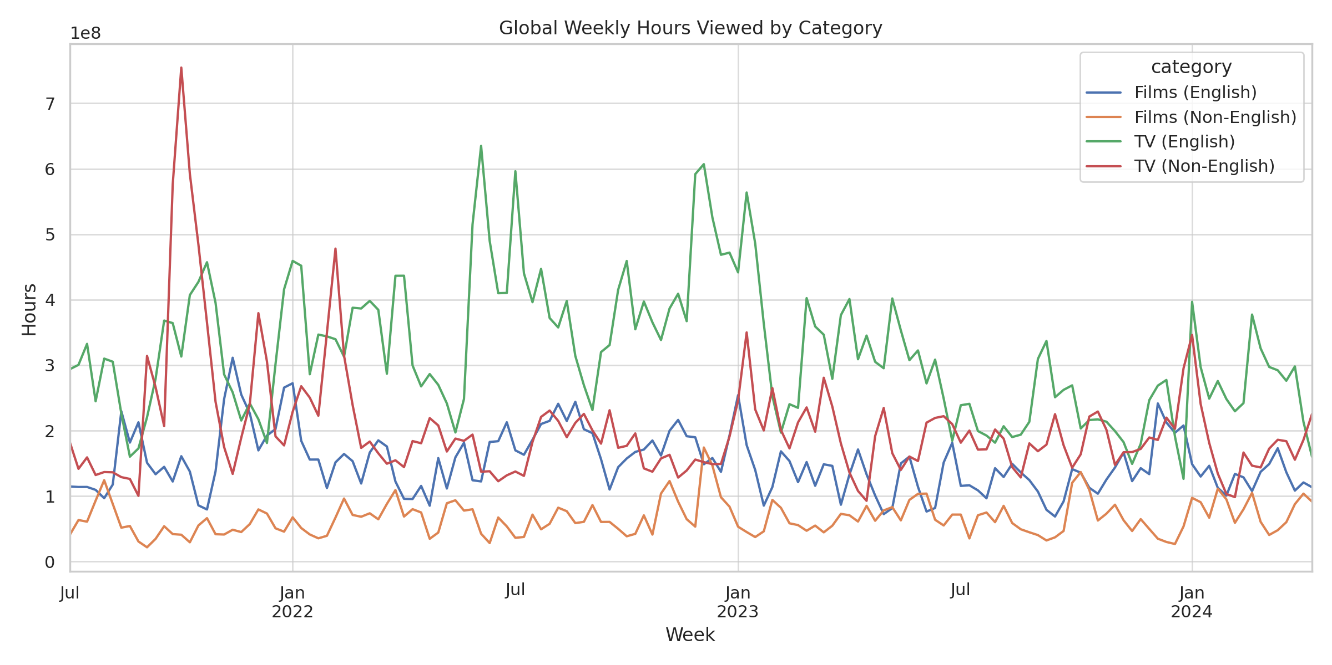
Global Weekly Hours by Category

Slide 9
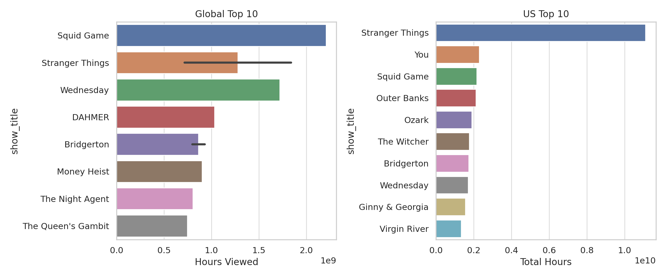
Global vs. US Top 10 Shows

Slide 10
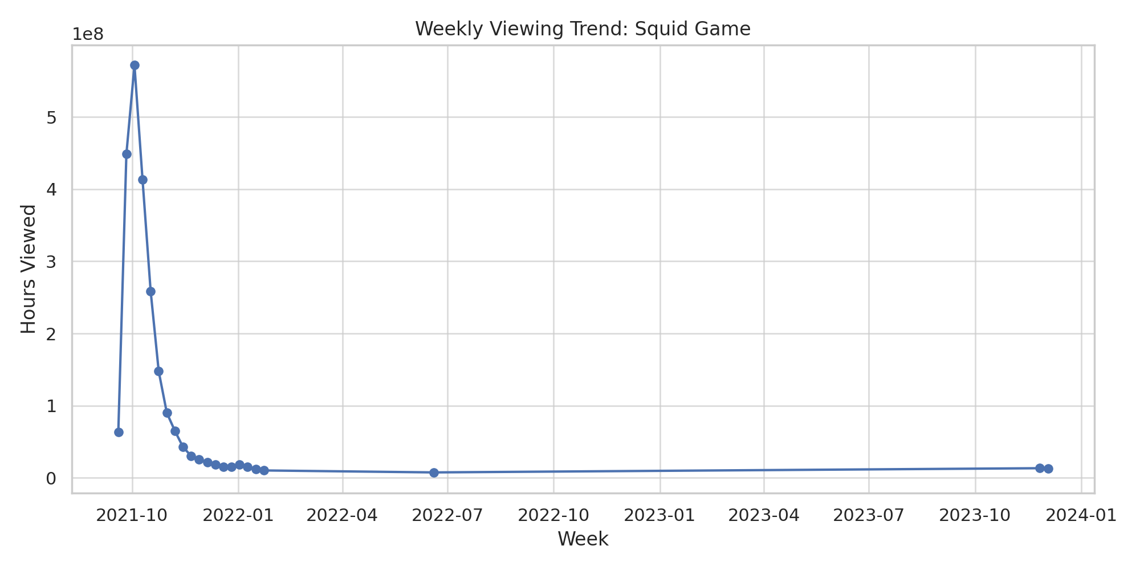
Squid Game Weekly Trend

Slide 11
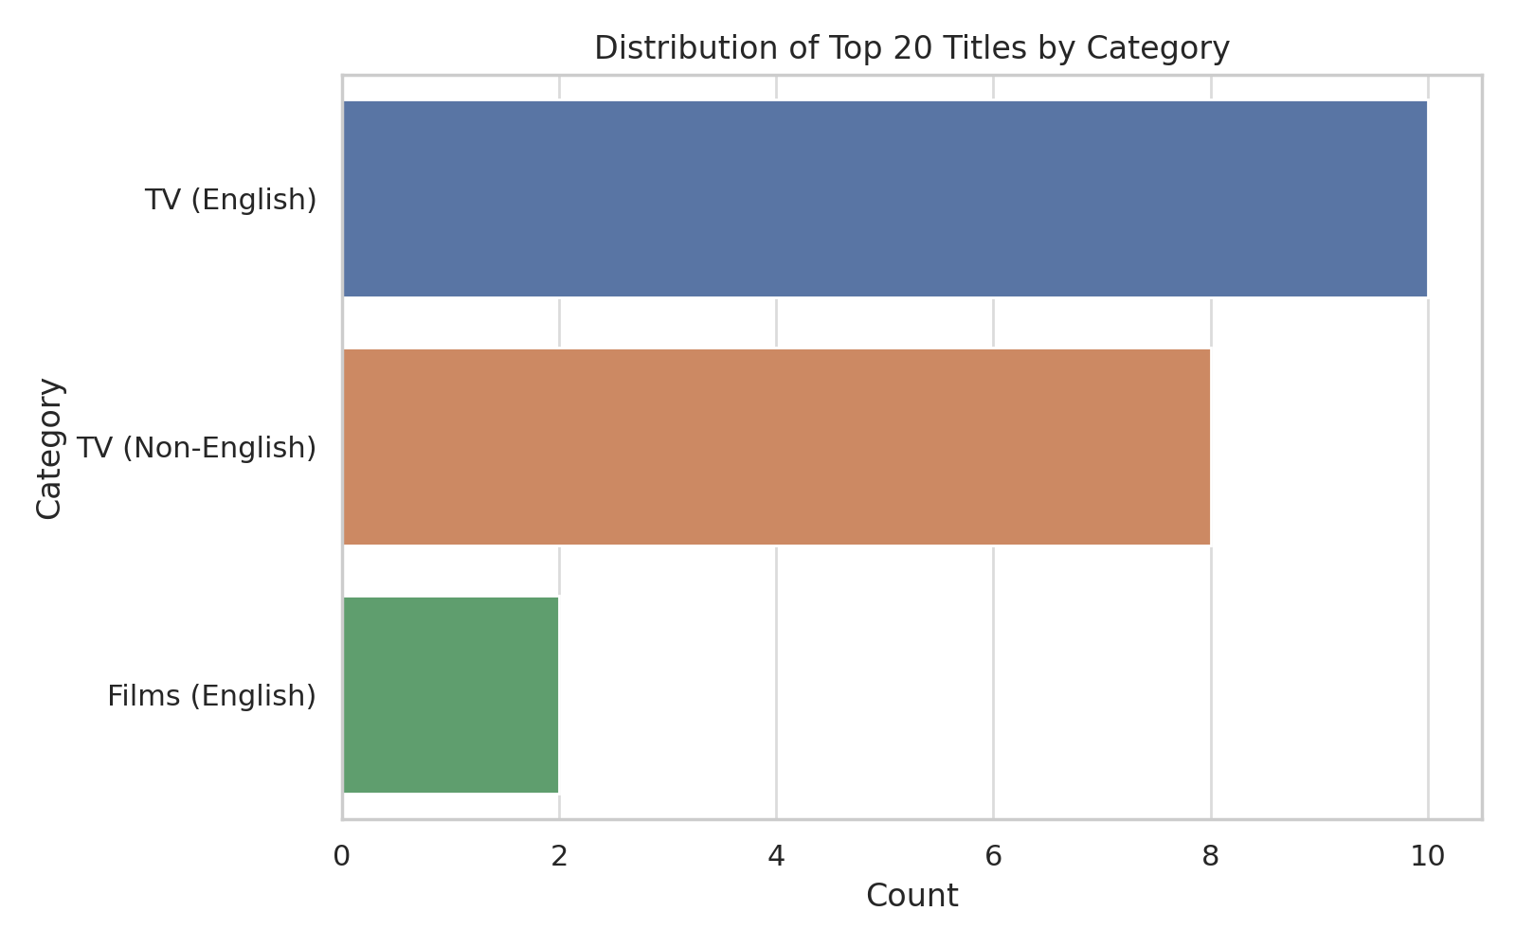
Category Distribution of Top 20

Slide 12
Conclusion & Call to Action
Recommend greenlighting a serialized drama with action elements, leveraging global and regional insights with a hybrid release strategy.

